Slide 1








SMART PLANT POT
By Team Spartans

Slide 2

"Plant Lovers core"

Slide 3
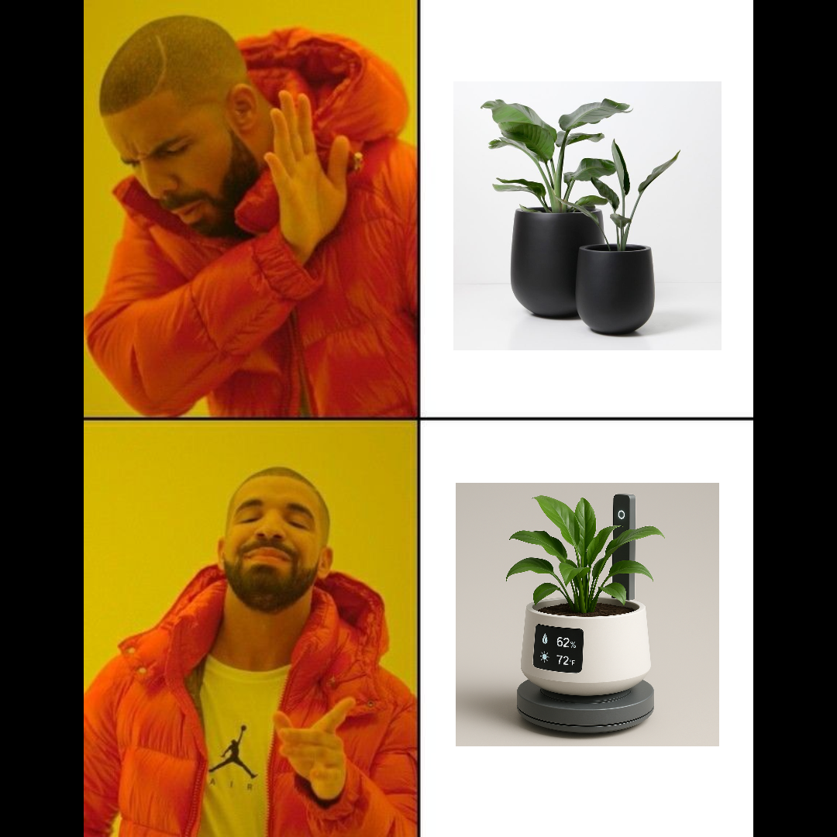
People Reaction After Getting Our Product

Slide 4

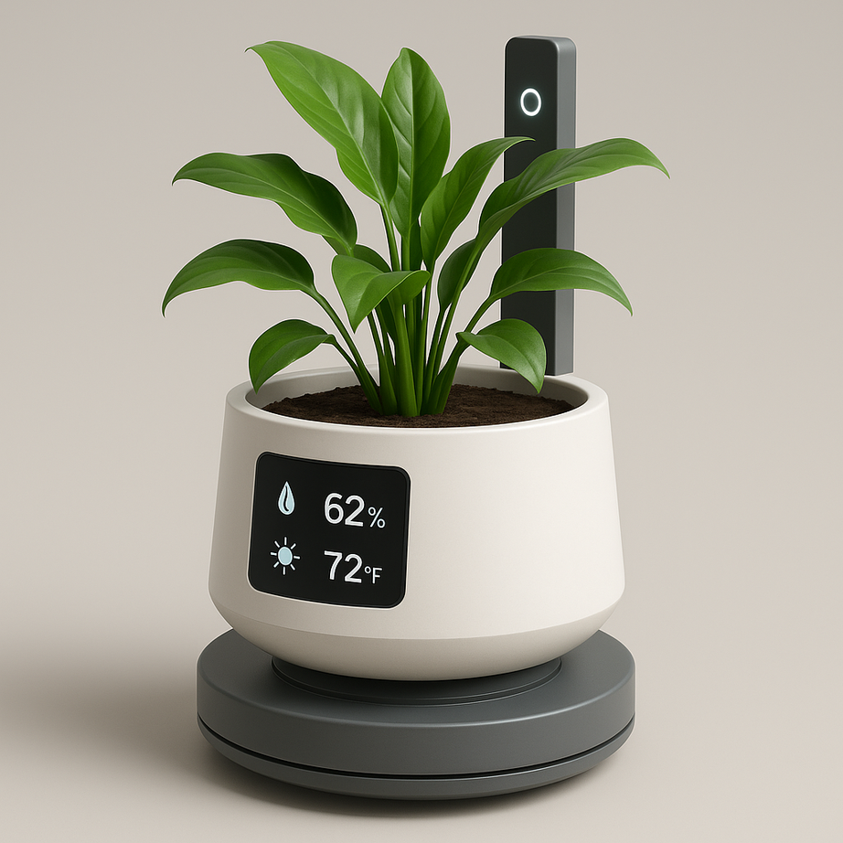

Slide 5

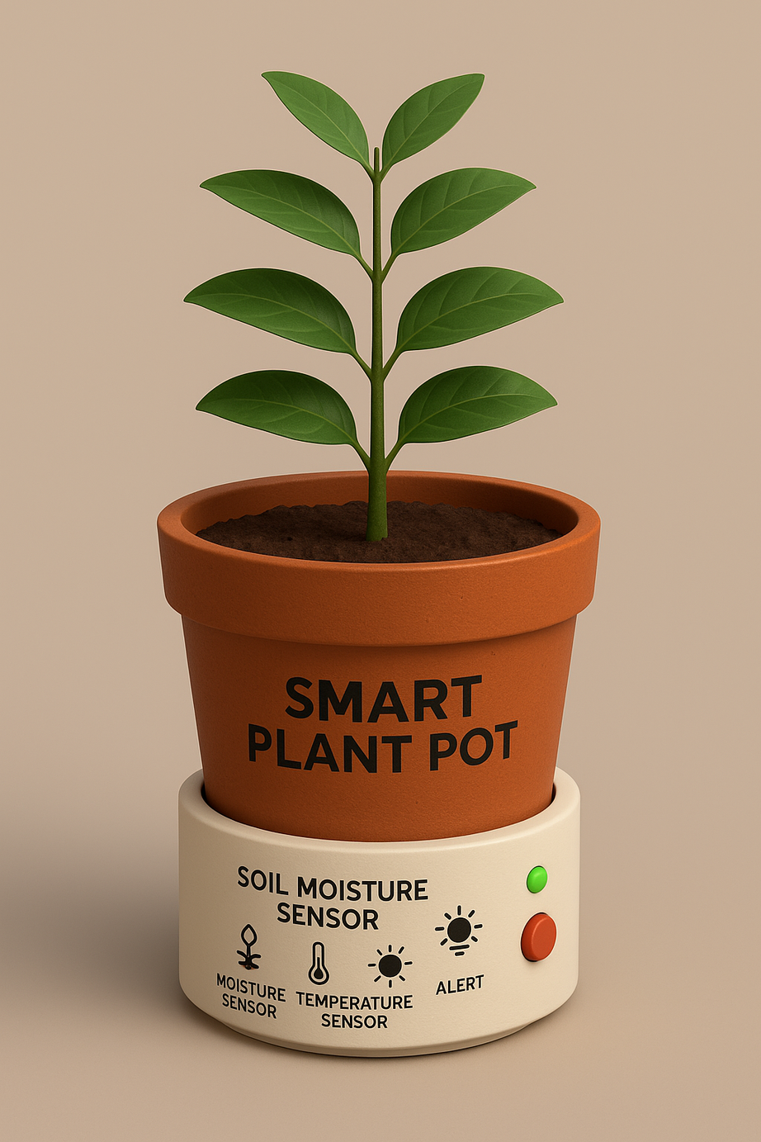

Slide 7


